Slide 1
Final Software Project
Chris Korn

Slide 2

Agenda
SRS Document
UML Design Model
Landing, Login, and Enrollment Pages
MySQL Database
PHP code

Slide 3

Introduction
My class registration website is a platform that allows students to sign up for courses or any educational programs online. It simplifies the process of registration by providing a convenient and user-friendly interface for users to browse available classes, select their preferences, and complete the registration process. Also for registrars to manage classes and teachers to view their class enrollments as well.

Slide 4
SRS Document
Software Requirements Specification

Slide 5
SRS Document
Project Purpose:
Create a functional end-user friendly system
Technology:
XAMPP, HTML, CSS, Bootstrap, MySQL, PHP
Requirements:
User can create account, login, and logout
User can view courses signed up for
User can add and remove courses
User is notified if class is waitlisted and if they have been waitlisted

Slide 6
UML Models
Unified Modeling Language

Slide 7
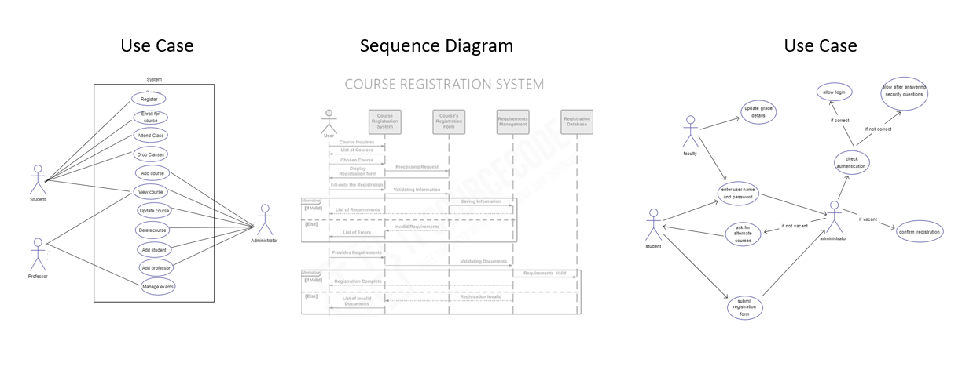
UML Models

Slide 8
Site Design
Course Enrollment

Slide 9
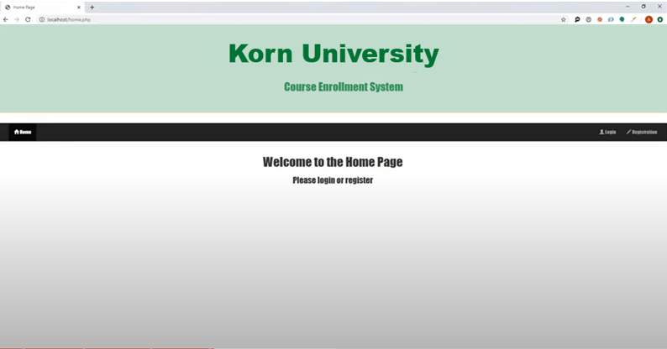
Landing Page

Slide 10
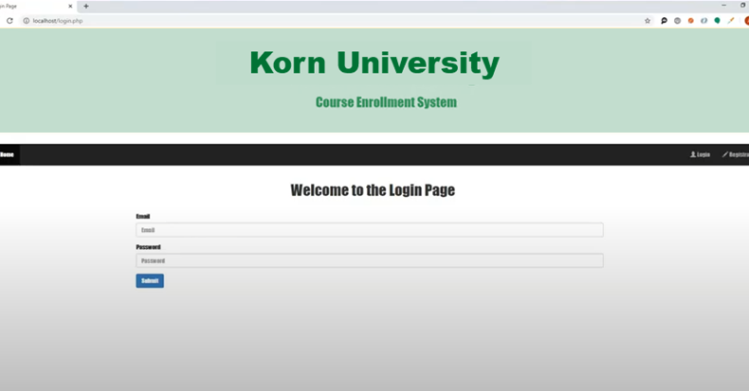
Login Page

Slide 11
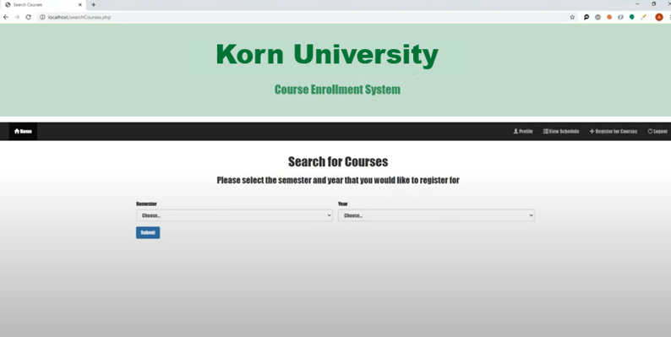
Enrollment Page

Slide 12



Summary
Was able to create a basic class enrollment system that allows users to sign in and enroll or unenroll in classes as needed. Was able to apply knowledge gained in our Software Technology class and apply that in making this system.

Slide 13




Thank you
Chris Korn
chriskorn@rocketmail.com
https://github.com/kornflakes208

